Slide 1
EDGE DETECTION
Presented by - Piyush M, Rubina A, Vallabh C, Satvik P

Slide 2
Introduction

Slide 3
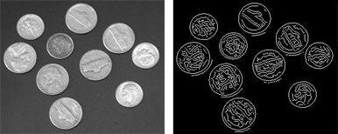
What is Edge Detection?
Edge detection is an image processing technique for finding the boundaries of objects within images. It works by detecting discontinuities in brightness. Edge detection is used for image segmentation and data extraction in areas such as image processing, computer vision, and machine vision.
Common edge detection algorithms include Sobel, Canny, Prewitt, Roberts, and fuzzy logic methods. We are using Canny method.

Slide 4
Literature Survey

Slide 5
Literature Survey
Edge Detection in colour images - A comparative study by Hanumanthappa M and S Regina Lourdhu Suganthi published in International Journal of Computer Application.
ALGORITHM AND TECHNIQUE ON VARIOUS EDGE DETECTION: A SURVEY published in Signal & Image Processing : An International Journal (SIPIJ) Vol.4, No.3, June 2013

Slide 6
Problem Formulation

Slide 7
Problem Formulation
With increasing security issues in public places and organisations of strategic importance to the nation, edge detection is applied to detect and recognize, intruders and criminal activities. The aim is to improve surveillance system for people to feel more secure.
This system can also be used in Attendance system in realtime by using this Project on CCTV Footage.

Slide 8
Tech Used
Software Requirements:
TensorFlow.JS
HTML5
Vanilla JS
TypeScript
ECMAScript 6+
Hardware Requirements:
Webcam or Phone Front Camera

Slide 9
How we
Trained our
TensorFlow.JS
Model
What exactly is TensorFlow.JS
A JavaScript library for training and deploying ML models in the browser and on Node.js
We got 4500 Images of faces from online dataset.
Dataset Link http://cbcl.mit.edu/software-datasets/heisele/facerecognition-database.html
Training : Testing Ratio
8:2

Slide 10
Implementation
The basic concept of this project is :
1. Smoothing the input image.
2. Calculating the horizontal gradient Gx and vertical gradient Gy at each pixel location.
3. Computing the gradient magnitude G and direction θG at each pixel location.
4. Applying Non-Maximal Suppression (NMS) to thin edges.
5. Computing high and low thresholds based on the histogram of the gradient magnitude for the entire image.
6. Performing hysteresis Thresholding.

Slide 11
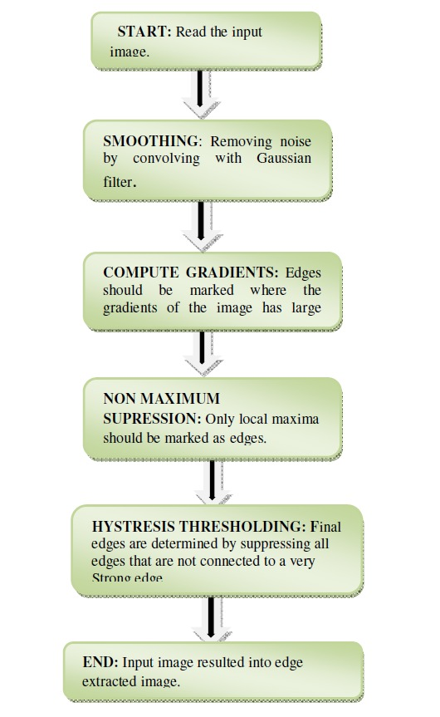
FLOWCHART
Canny Edge Detection

Slide 12
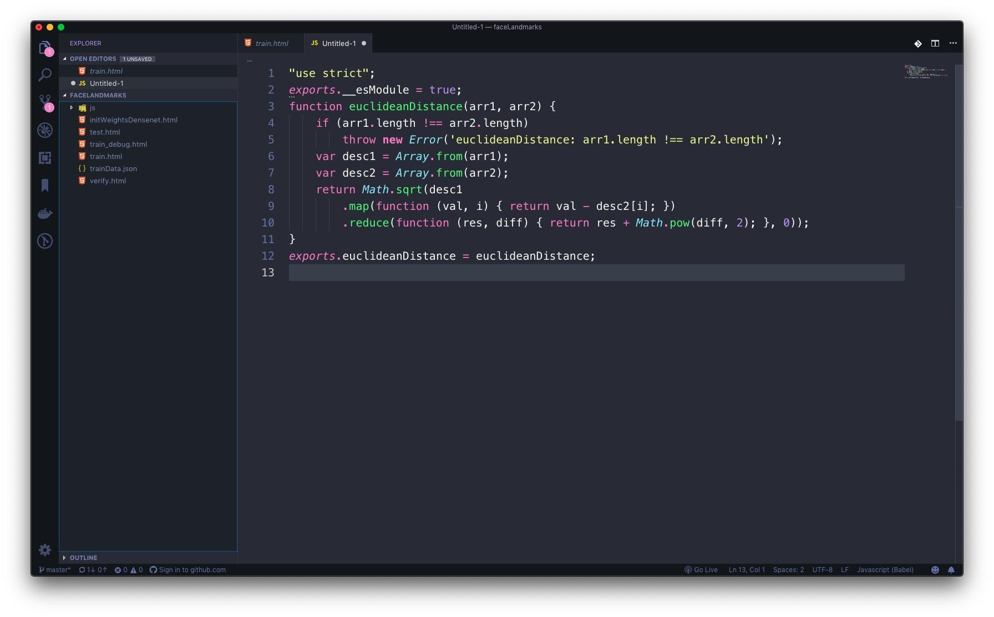
Euclidean Distance

Slide 13

Testing DataSet

Slide 14

Training DataSet

Slide 15
Drawbacks
The result is binary. You sometimes need a measure of 'how much' the edge qualifies as an edge (e.g. intensity image coming from a Sobel amplitude edge detector)
Need to connect the resulting edges to extract the complete edges that seem so obvious for the human eye+mind.
Due to the gaussian smoothing: the location of the edges might be off, depending on the size of the gaussian kernel.
The method has problems with corners and junctions:
The gaussian smoothing blurs them out, making them harder to detect (same goes for the edges themself)
The corner pixels look in the wrong directions for their neighbors, leaving open ended edges, and missing junctions

Slide 16
WORKING

Slide 17
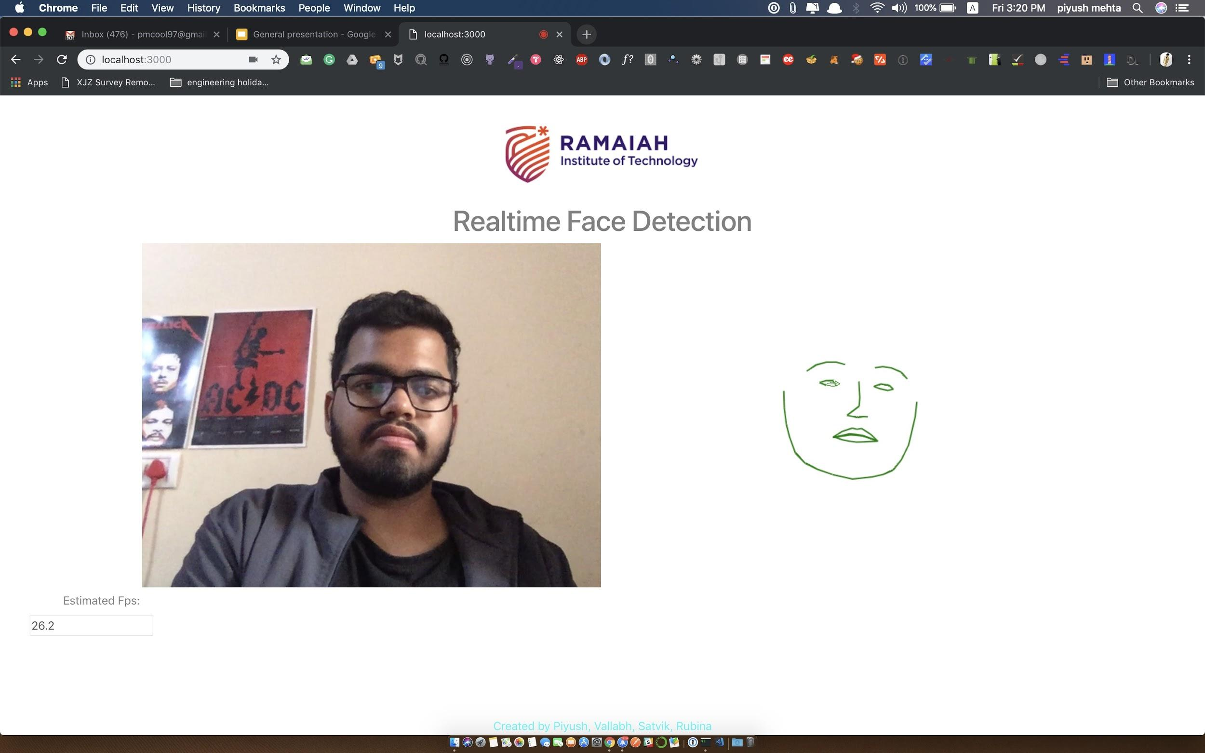
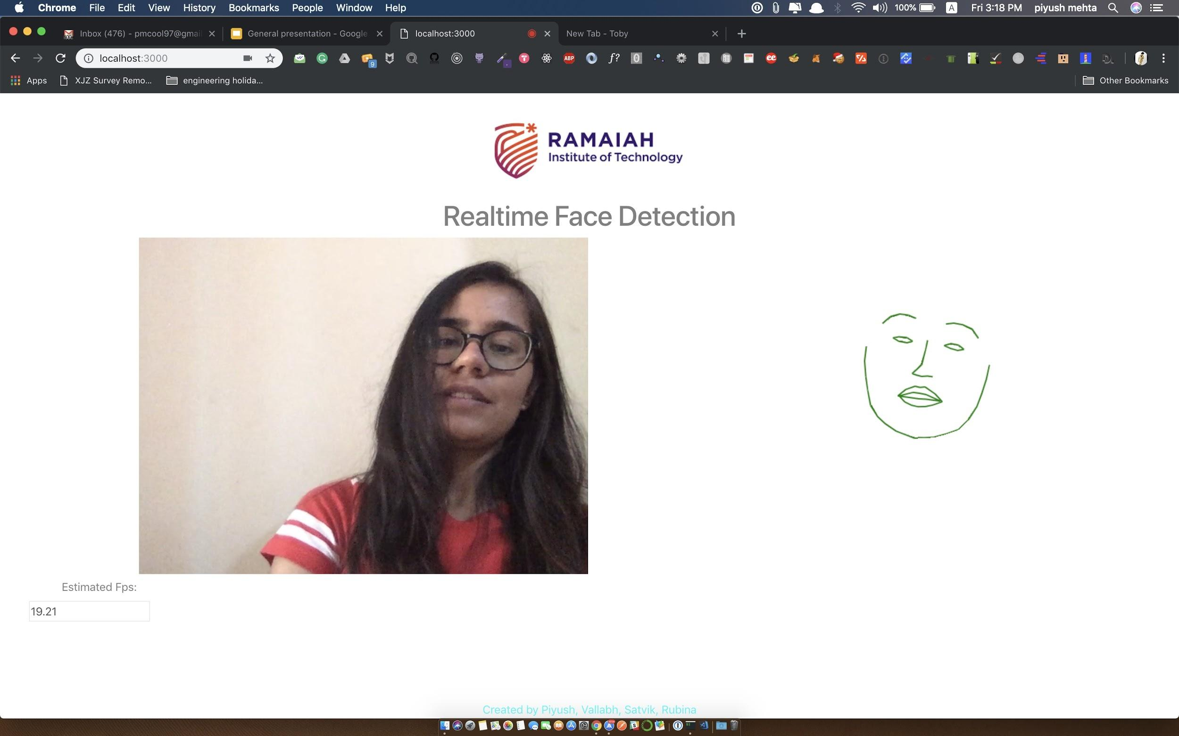
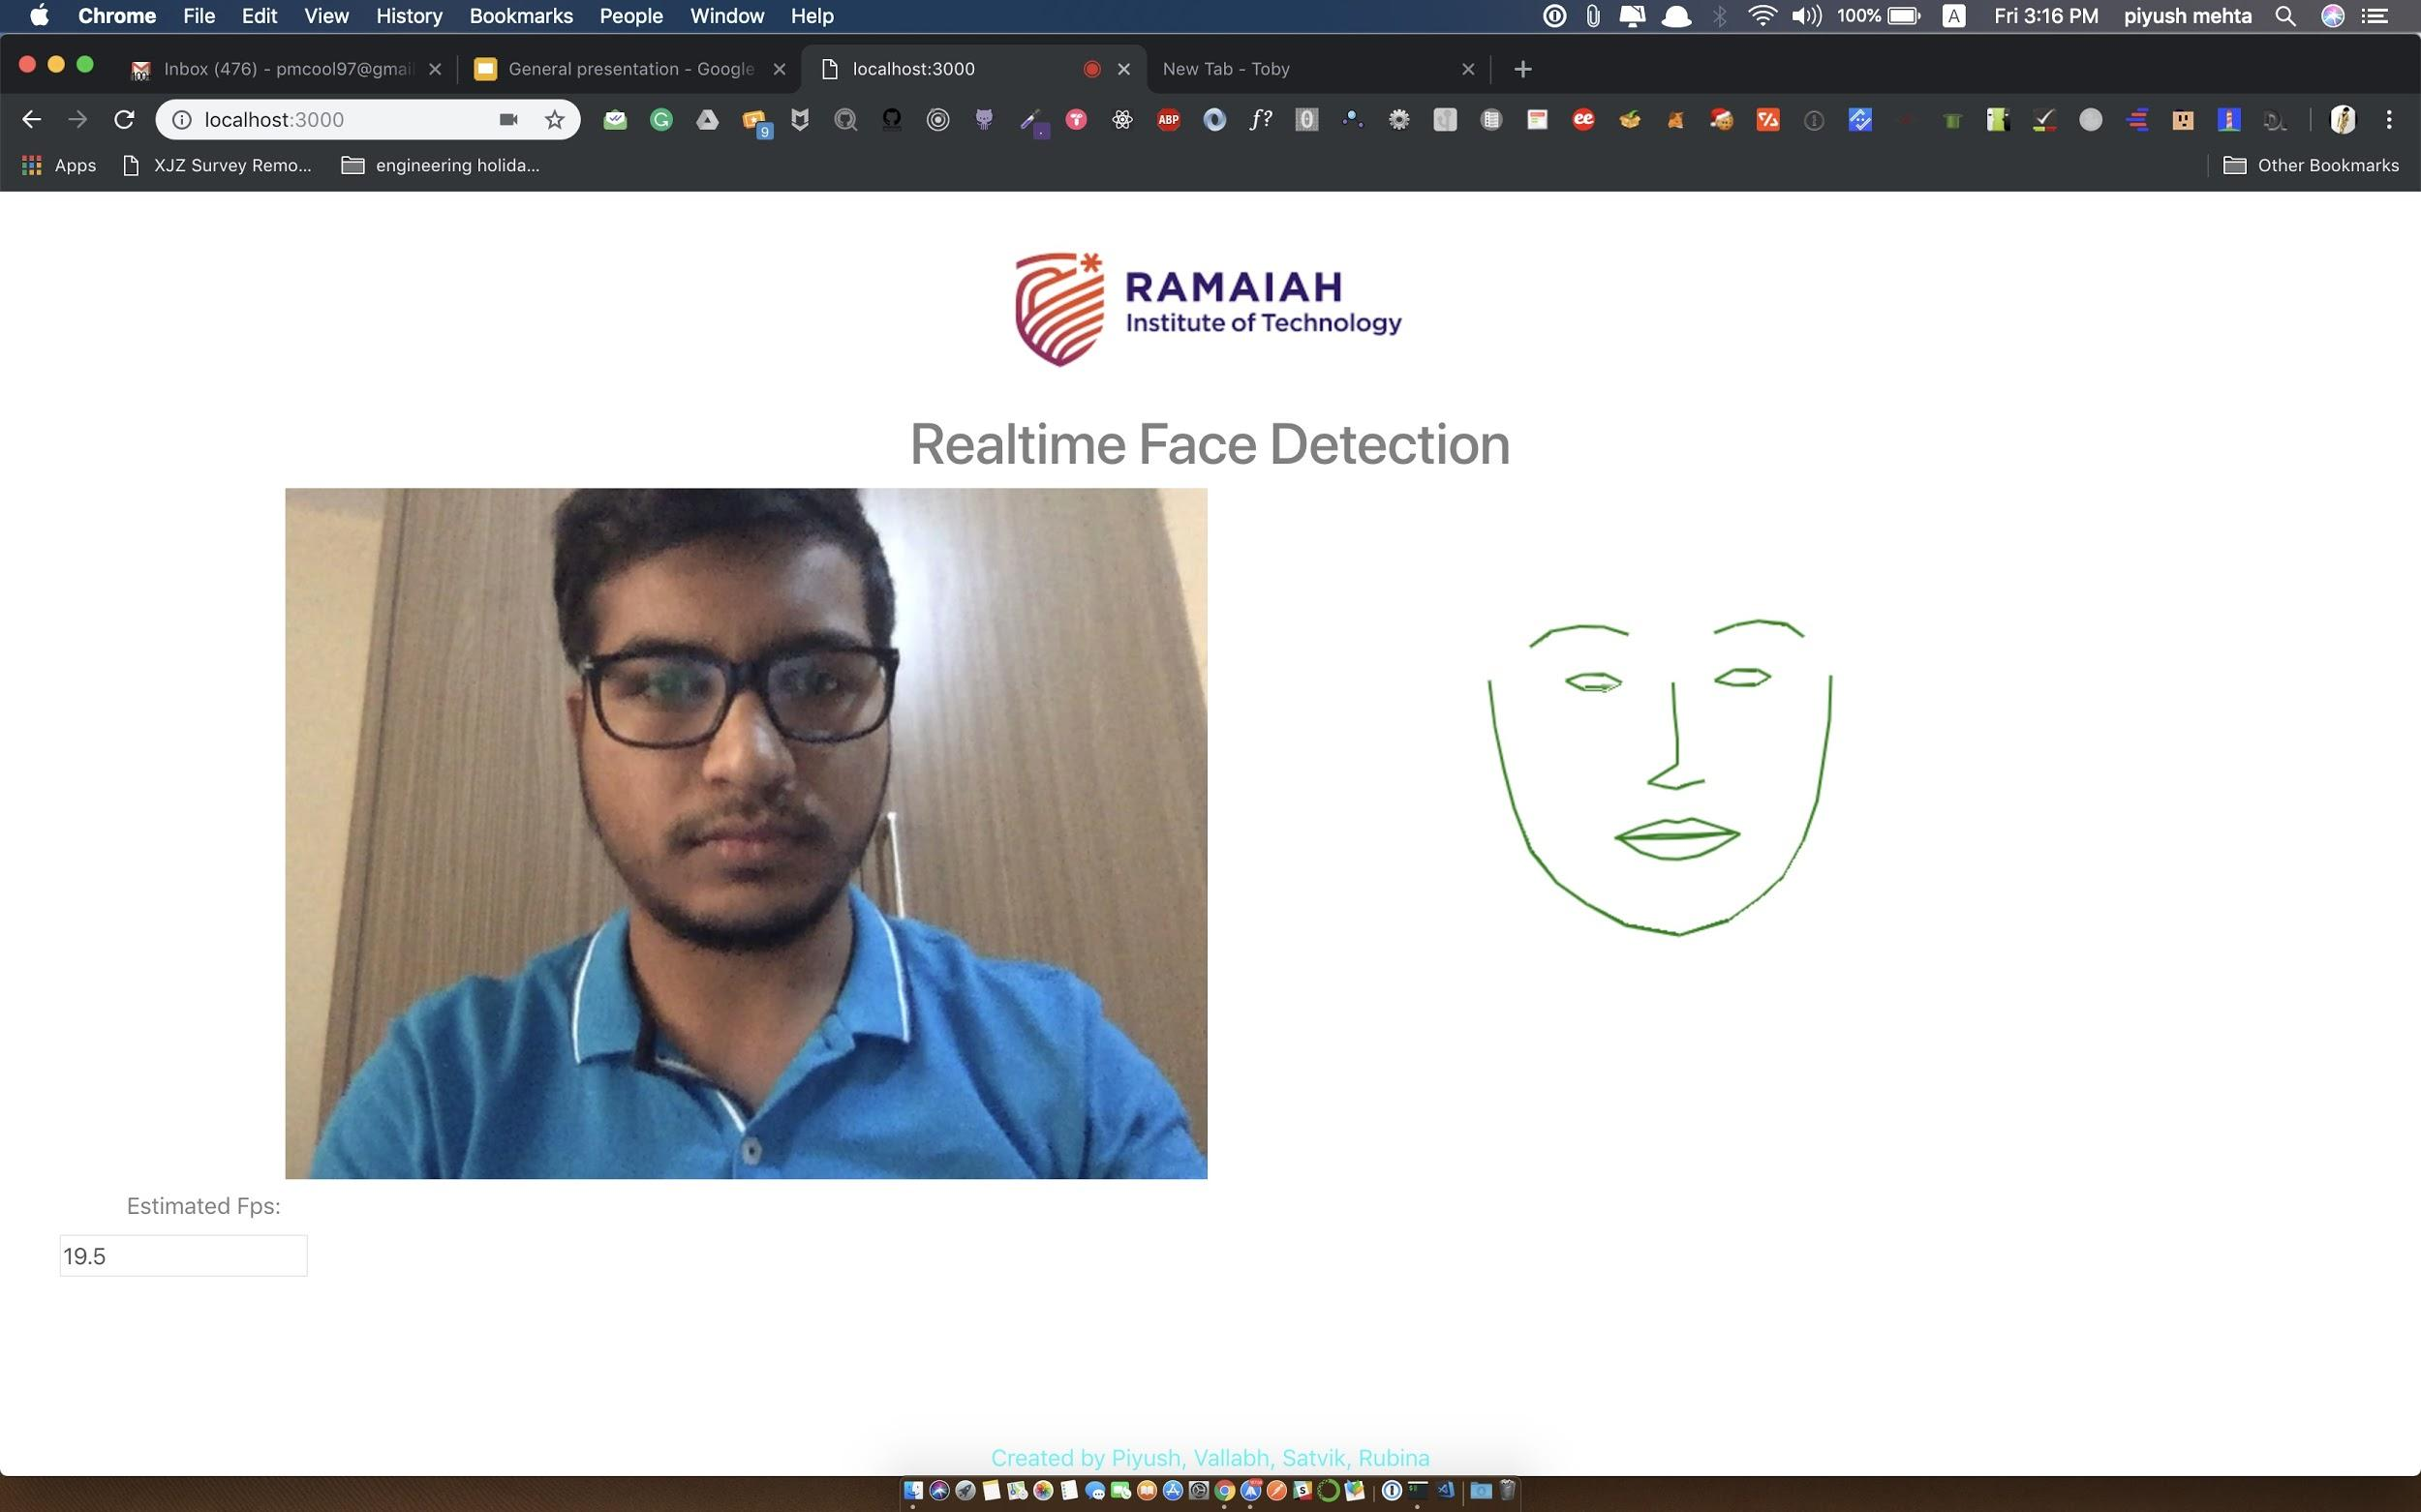
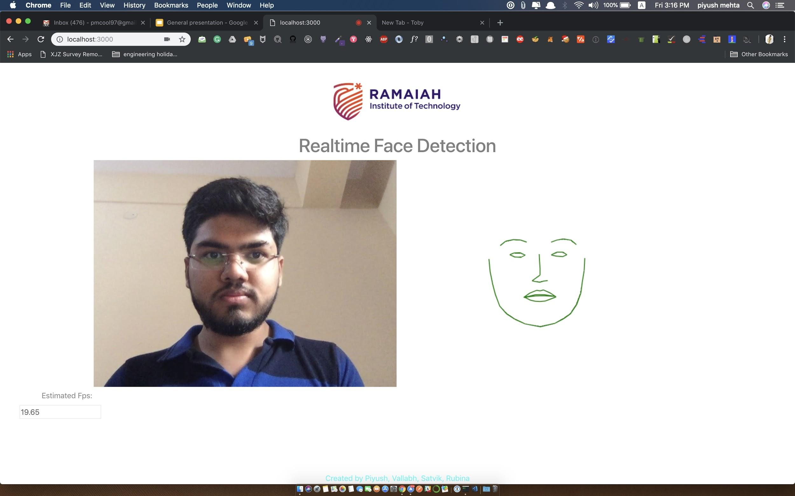
Screenshots

Slide 18

Algorithm

Slide 19
91%
Accuracy in detecting the Eyes, Mouth and Faceline.

Slide 20
Conclusion and Future Scope
It has been observed that canny edge detection method gives better results as compared to other methods.
It is less sensitive to noise, adaptive in nature, resolved the problem of streaking, provides good localization and detects sharper edges as compared to others.
It finds practical application in Runway Detection and Tracking for Unmanned Aerial Vehicle, in brain MRI image, public safety and military department,cable insulation layer measurement, Real-time facial expression recognition, edge detection of river regime, Automatic Multiple Faces Tracking and Detection.

Slide 21
Thank You!

